Slide 1
Temporal Calibration of Tracked Freehand Ultrasound
Eric Moult
Andras Lasso
Laboratory for Percutaneous Surgery School of Computing, Queen’s University, Canada

Slide 2
Motivation
Tracked freehand US
Similar to regular US except probe’s pose is tracked
Problem: Temporal misalignment between pose and image data
Caused by different hardware delays in video acquisition and pose tracking systems

Slide 3
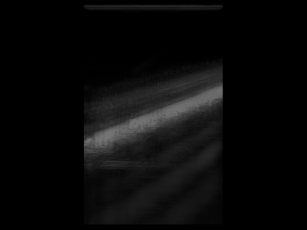
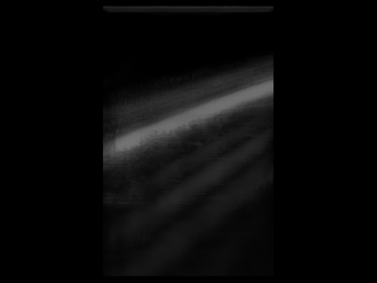
Motivation
Tracker Pose Stream
Image Stream
Time

Slide 4
Motivation
Tracker Pose Stream
Image Stream
Time
Time Offset

Slide 5
Motivation
Temporal calibration
Process of finding the time offset between the tracker and image data streams
Temporal calibration should be:
Fully automatic
Fast (< 10 seconds)
Robust
No specialized hardware
Ideally open source

Slide 6
Methodology
Based on Treece et al. (2003, Ultrasound in Med. & Biol)
Image an object that produces a line feature (e.g. bottom of a water bath)
Record data while probe undergoes periodic motion along a single axis
Extract position signals from tracker and video streams
Find the time-shift that best aligns the two signals

Slide 7
Methodology
Algorithm Overview
Tracker Sequence
Image Sequence
Compute tracker position metric
Compute image position metric
Correlate tracker and position metrics
Time Offset

Slide 8
Methodology
Algorithm Overview
Tracker Sequence
Image Sequence
Compute tracker position metric
Compute image position metric
Correlate tracker and position metrics
Time Offset

Slide 9
Methodology
Compute tracker position metric
Tracker Sequence
STEP1 Project onto principal axis
STEP2 Compute distance from mean
Tracker Position Metric

Slide 10
Methodology
Compute tracker position metric
Tracker Sequence
STEP1 Project onto principal axis
STEP2 Compute distance from mean
Tracker Position Metric

Slide 11
Methodology
STEP1: Project onto principal axis
Use PCA to find principal axis of variation

Slide 12
Methodology
STEP1: Project onto principal axis
Use PCA to find principal axis of variation

Slide 13
Methodology
STEP1: Project onto principal axis
Use PCA to find principal axis of variation

Slide 14
Methodology
Compute tracker position metric
Tracker Sequence
STEP1 Project onto principal axis
STEP2 Compute distance from mean
Tracker Position Metric

Slide 15

Methodology
Compute tracker position metric
Tracker Sequence
STEP1 Project onto principal axis
STEP2 Compute distance from mean
Tracker Position Metric

Slide 16
Methodology
STEP2: Compute distance from mean

Slide 17
Methodology
STEP2: Compute distance from mean
Tracker position metric

Slide 18
Methodology
Compute tracker position metric
Tracker Sequence
STEP1 Project onto principal axis
STEP2 Compute distance from mean
Tracker Position Metric

Slide 19
Methodology
Compute tracker position metric
Tracker Sequence
STEP1 Project onto principal axis
STEP2 Compute distance from mean
Tracker Position Metric

Slide 20
Methodology
Algorithm Overview
Tracker Sequence
Image Sequence
Compute tracker position metric
Compute image position metric
Correlate tracker and position metrics
Time Offset

Slide 21
Methodology
Algorithm Overview
Tracker Sequence
Image Sequence
Compute tracker position metric
Compute image position metric
Correlate tracker and position metrics
Time Offset

Slide 22
Methodology
First attempt: Use Hough transform to find position metric
SLOW!!
Run-time for 500 image sequence was > 2 minutes
The thickness of the line in US image caused ambiguity in the which line would be chosen
Results in detected line “flipping” back and forth

Slide 23
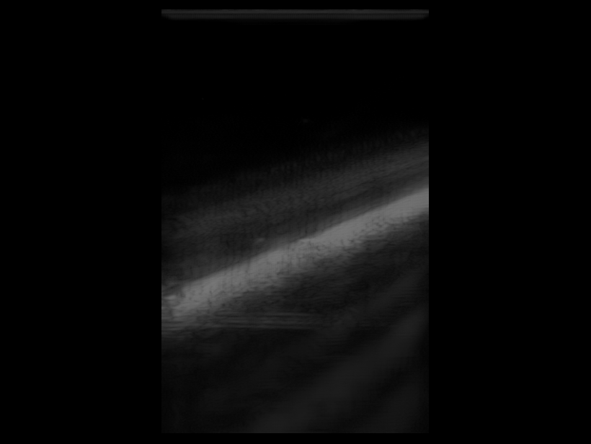
Methodology
First attempt: Hough transform

Slide 24
Methodology
First attempt: Hough transform
Thickness causes Ambiguity

Slide 25
Methodology
Compute image position metric
Image Sequence
STEP1 Compute intensity profile metric
STEP2 Line fitting
STEP3 Compute distance from mean
Image Position Metric

Slide 26
Methodology
Compute image position metric
Image Sequence
STEP1 Compute intensity profile metric
STEP2 Line fitting
STEP3 Compute distance from mean
Image Position Metric

Slide 27
Methodology
STEP1: Compute intensity profile metric

Slide 28

Methodology
STEP1: Compute intensity profile metric

Slide 29
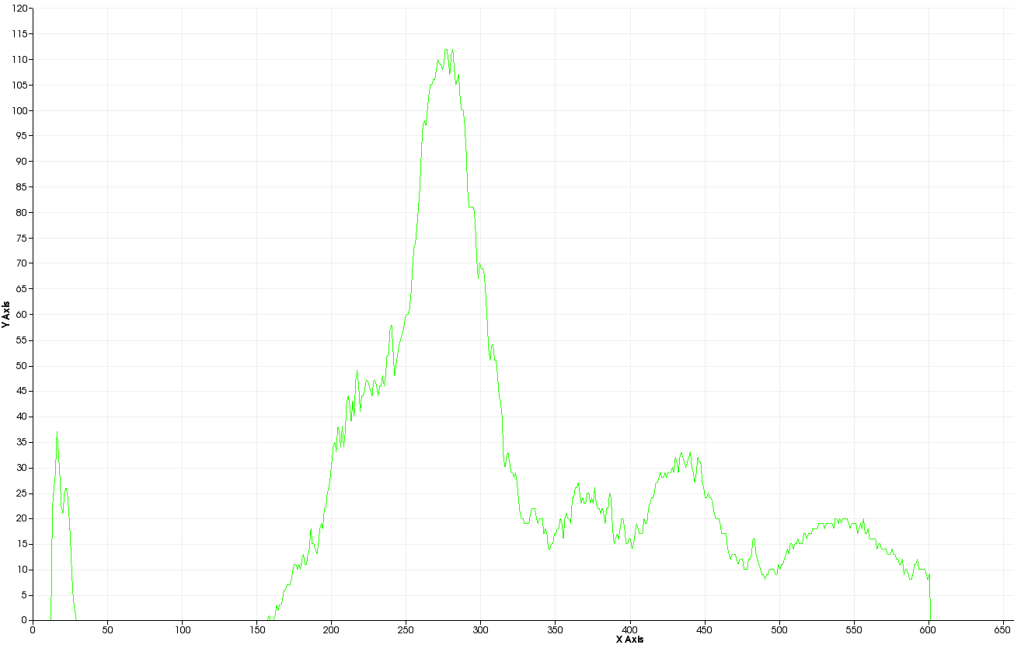
Methodology
STEP1: Compute intensity profile metric
Grayscale Intensity
Distance from top of image (pixels)

Slide 30
Methodology
STEP1: Compute intensity profile metric
50% of Peak
Grayscale Intensity
Distance from top of image (pixels)

Slide 31
Methodology
STEP1: Compute intensity profile metric
50% of Peak
COG
Grayscale Intensity
Distance from top of image (pixels)

Slide 32
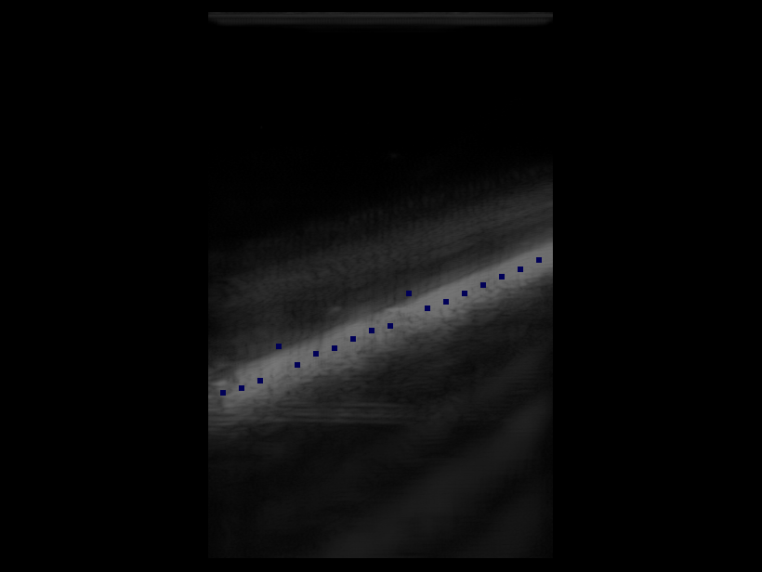
Methodology
STEP1: Compute intensity profile metric

Slide 33
Methodology
Compute image position metric
Image Sequence
STEP1 Compute intensity profile metric
STEP2 Line fitting
STEP3 Compute distance from mean
Image Position Metric

Slide 34
Methodology
Compute image position metric
Image Sequence
STEP1 Compute intensity profile metric
STEP2 Line fitting
STEP3 Compute distance from mean
Image Position Metric

Slide 35
Methodology
STEP2: Line fitting

Slide 36
Methodology
STEP2: RANSAC line fitting
Implementation by Yaniv (2010, Insight Journal)
Robust to outliers
Non-deterministic, but fast (< 5 sec for 500+ images)

Slide 37
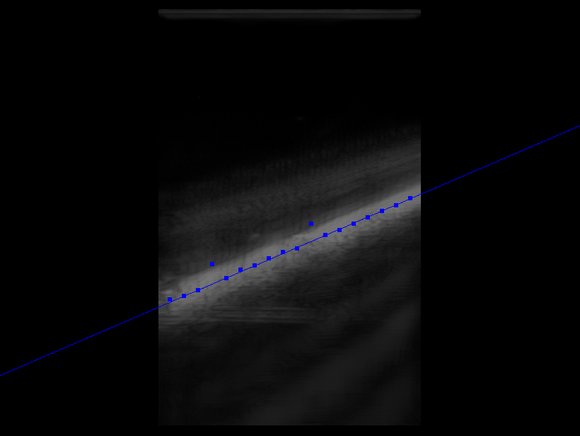
Methodology
STEP2: RANSAC line fitting

Slide 38
Methodology
STEP2: RANSAC line fitting

Slide 39
Methodology
Compute image position metric
Image Sequence
STEP1 Compute intensity profile metric
STEP2 Line fitting
STEP3 Compute distance from mean
Image Position Metric

Slide 40
Methodology
Compute image position metric
Image Sequence
STEP1 Compute intensity profile metric
STEP2 Line fitting
STEP3 Compute distance from mean
Image Position Metric

Slide 41
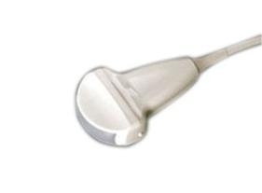
Methodology
STEP3: Compute distance from mean
Detected line

Slide 42
Methodology
STEP3: Compute distance from mean
Detected line
Line midpoint

Slide 43
Methodology
STEP3: Compute distance from mean
Detected line
Line midpoint
Mean midpoint

Slide 44
Methodology
STEP3: Compute distance from mean
Detected line
Image position
metric
Line midpoint
Mean midpoint

Slide 45
Methodology
Compute image position metric
Image Sequence
STEP1 Compute intensity profile metric
STEP2 Line fitting
STEP3 Compute distance from mean
Image Position Metric

Slide 46
Methodology
Compute image position metric
Image Sequence
STEP1 Compute intensity profile metric
STEP2 Line fitting
STEP3 Compute distance from mean
Image Position Metric

Slide 47
Methodology
Algorithm Overview
Tracker Sequence
Image Sequence
Compute tracker position metric
Compute image position metric
Correlate tracker and position metrics
Time Offset

Slide 48
Methodology
Algorithm Overview
Tracker Sequence
Image Sequence
Compute tracker position metric
Compute image position metric
Correlate tracker and position metrics
Time Offset

Slide 49
Methodology
Correlate tracker and position metrics
Tracker Position Metric
Image Position Metric
STEP1 Normalize position metrics
STEP2 Align position metrics
Time Offset

Slide 50
Methodology
Correlate tracker and position metrics
Tracker Position Metric
Image Position Metric
STEP1 Normalize position metrics
STEP2 Align position metrics
Time Offset

Slide 51
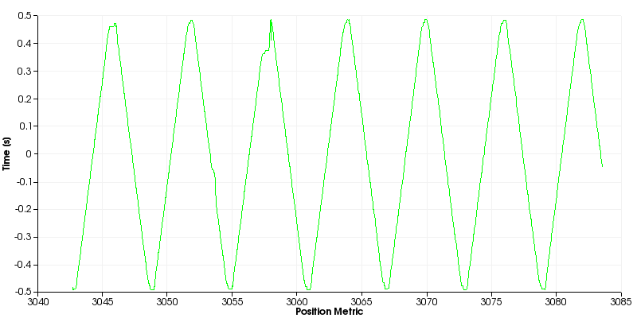
Methodology
STEP1 Normalize tracker position metric

Slide 52
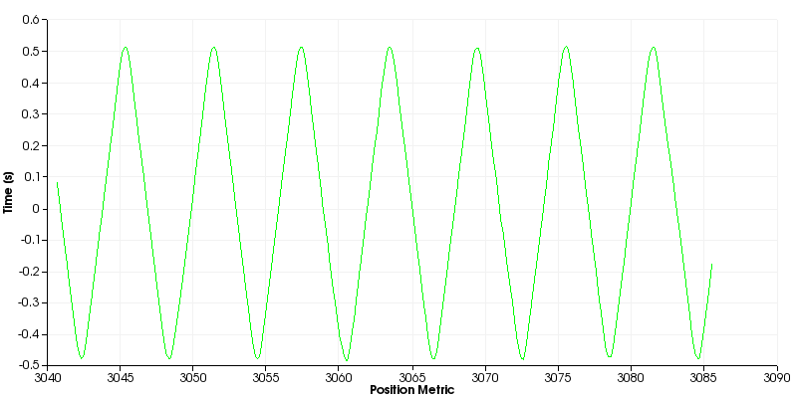
Methodology
STEP1 Normalize image position metric

Slide 53
Methodology
Correlate tracker and position metrics
Tracker Position Metric
Image Position Metric
STEP1 Normalize position metrics
STEP2 Align position metrics
Time Offset

Slide 54
Methodology
Correlate tracker and position metrics
Tracker Position Metric
Image Position Metric
STEP1 Normalize position metrics
STEP2 Align position metrics
Time Offset

Slide 55
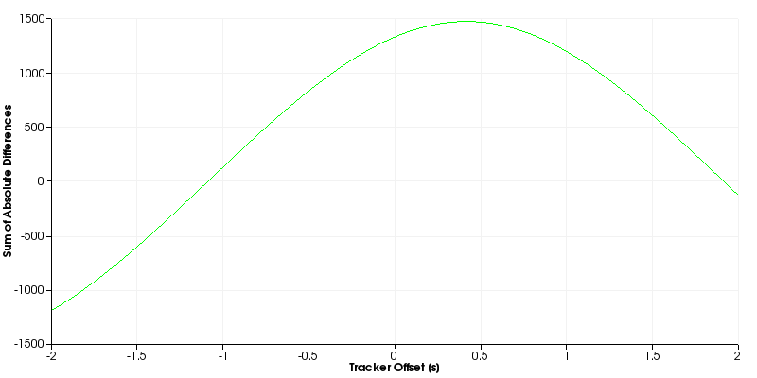
Methodology
Cross-correlation (Xcorr)

Slide 56
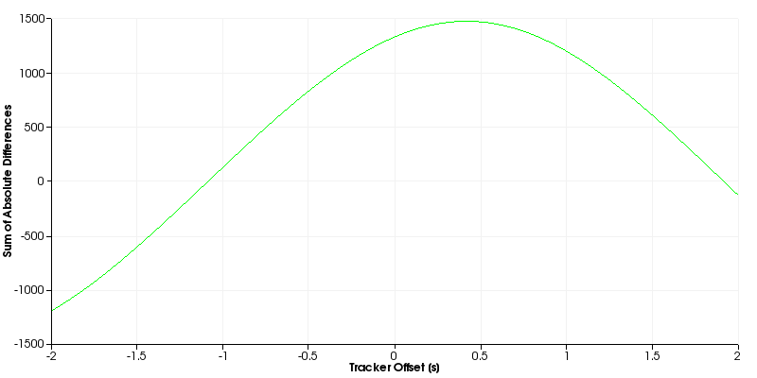
Methodology
Sum of absolute differences (SAD)

Slide 57
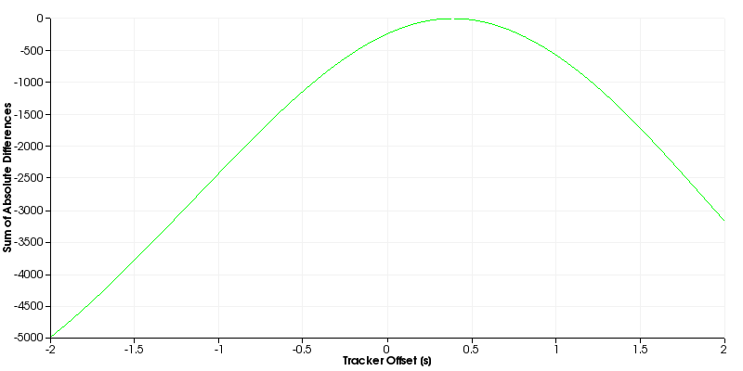
Methodology
Sum of squared differences (SSD)

Slide 58
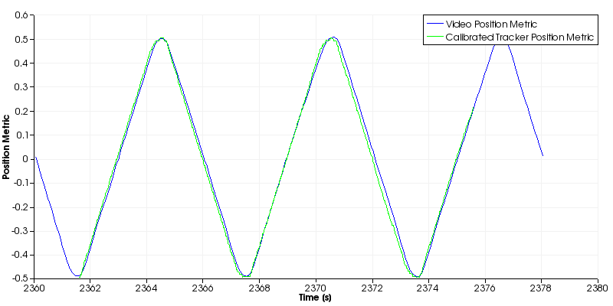
Methodology
Xcorr

Slide 59
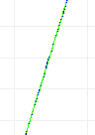
Methodology
Xcorr

Slide 60
Methodology
Xcorr

Slide 61
Methodology
Xcorr

Slide 62
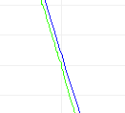
Methodology
Xcorr

Slide 63
Methodology
Xcorr
Green leads
Green leads
Green leads
Green leads

Slide 64

Methodology
Xcorr

Slide 65
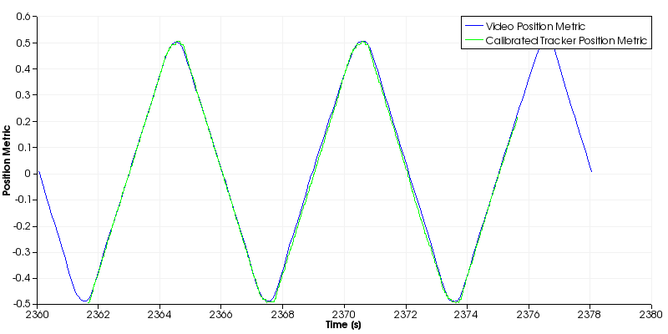
Methodology
SSD

Slide 66
Methodology
SSD

Slide 67
Methodology
SSD
Green lags
Green leads

Slide 68
Methodology
SSD

Slide 69
Methodology
Correlate tracker and position metrics
Tracker Position Metric
Image Position Metric
STEP1 Normalize position metrics
STEP2 Align position metrics
Time Offset

Slide 70
Methodology
Correlate tracker and position metrics
Tracker Position Metric
Image Position Metric
STEP1 Normalize position metrics
STEP2 Align position metrics
Time Offset

Slide 71
Methodology
Algorithm Overview
Tracker Sequence
Image Sequence
Compute tracker position metric
Compute image position metric
Correlate tracker and position metrics
Time Offset

Slide 72
Methodology
Algorithm Overview
Tracker Sequence
Image Sequence
Compute tracker position metric
Compute image position metric
Correlate tracker and position metrics
Time Offset

Slide 73
Validation
115 sequences collected with position stage
Collected under varying parameters:
Dynamic range
Depth
Gain
Different materials
Number of focal points
30 sequences collected under freehand motion

Slide 74
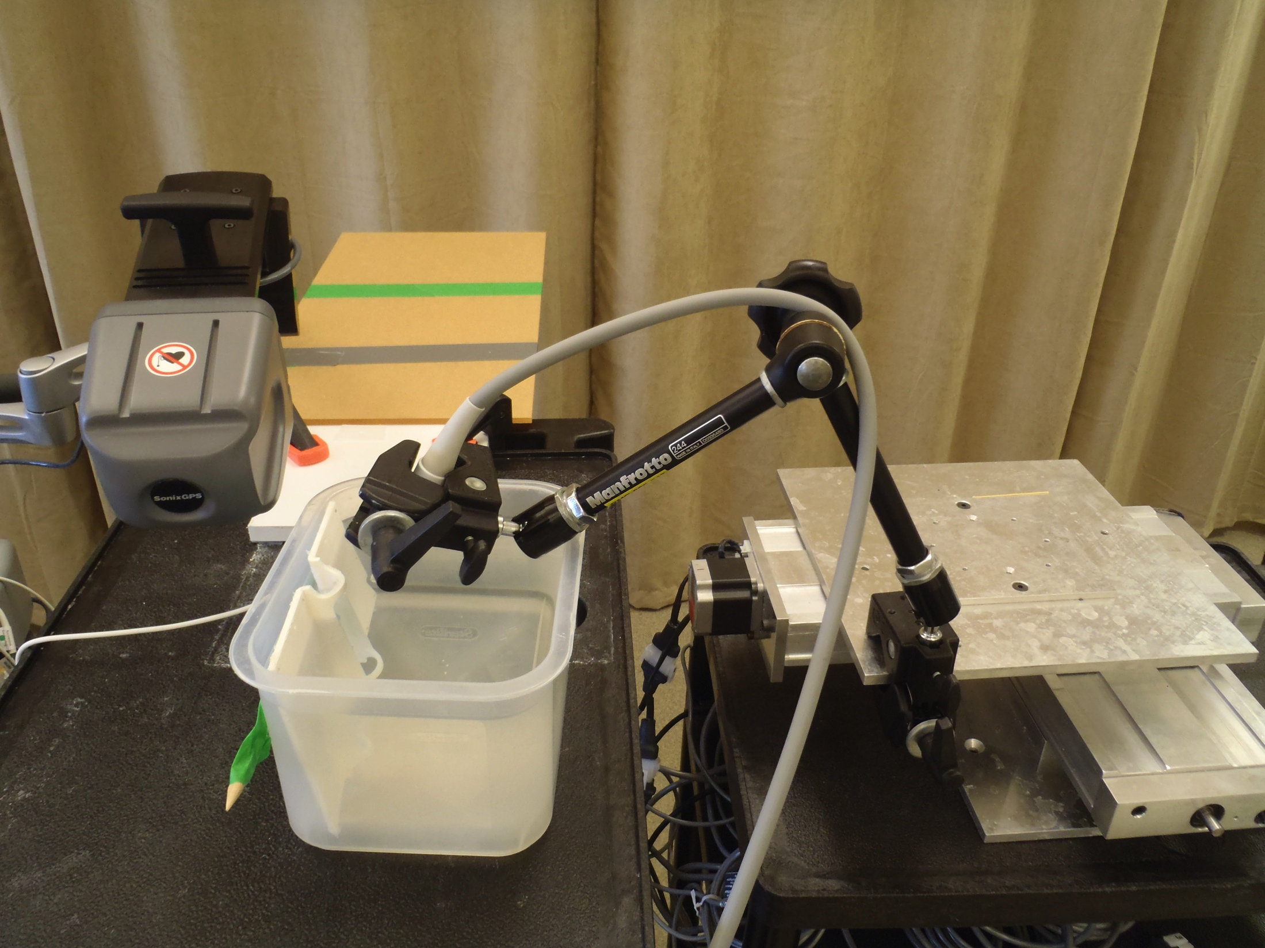
Validation
Robotic positioning set-up

Slide 75
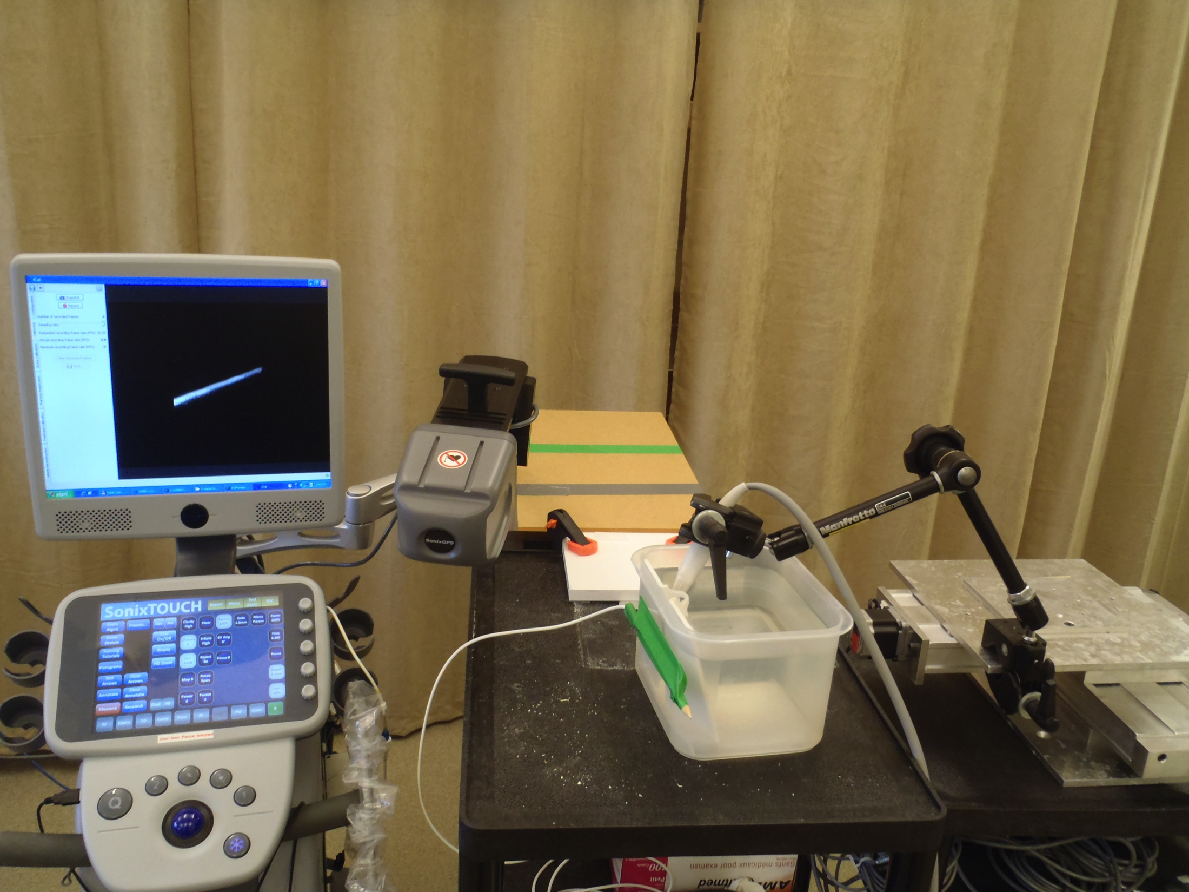
Validation
Robotic positioning set-up

Slide 76
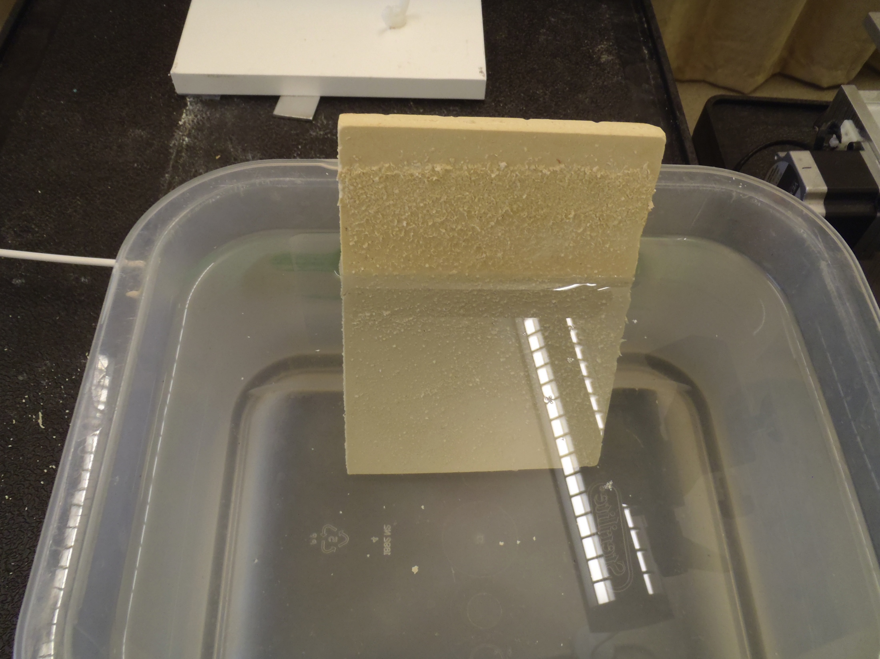
Validation
Robotic positioning set-up

Slide 77
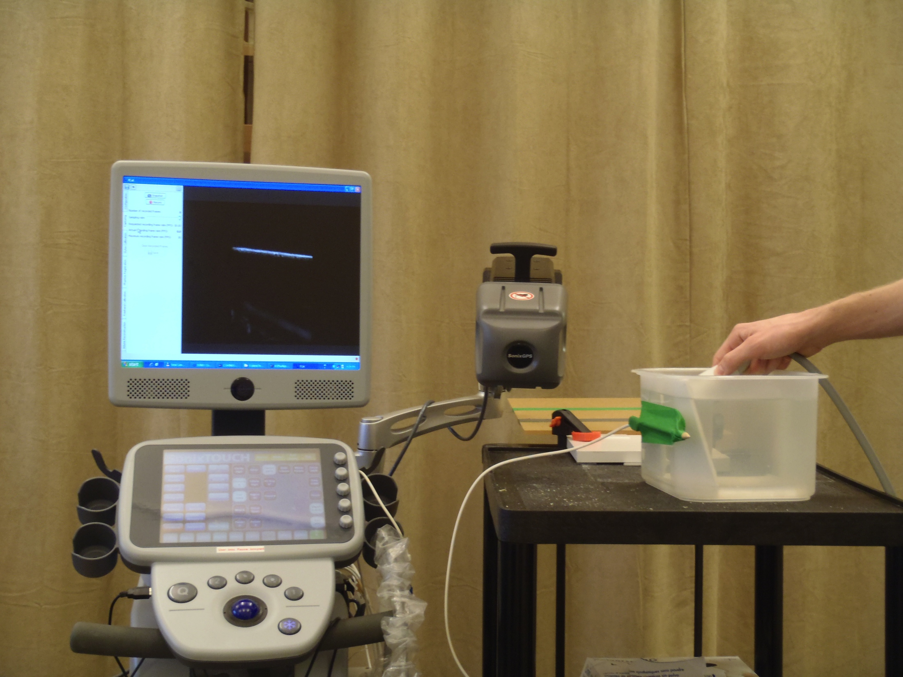
Validation
Freehand set-up

Slide 78
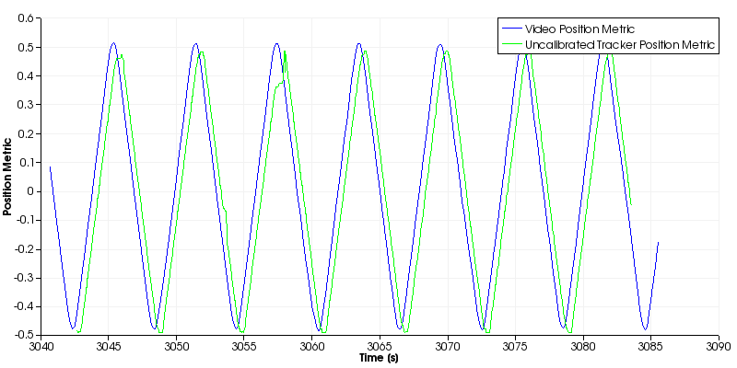
Results
Positioning stage: Before alignment

Slide 79
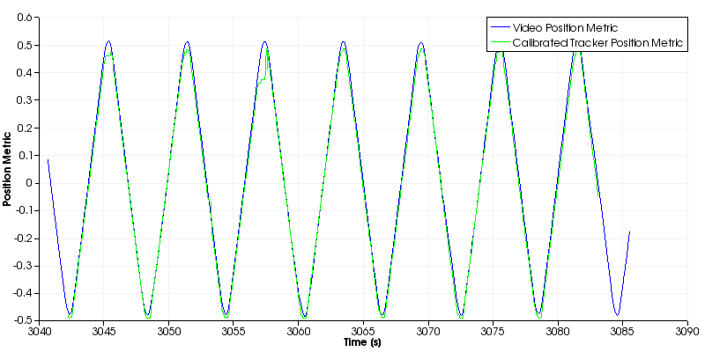
Results
Positioning stage: After alignment

Slide 80
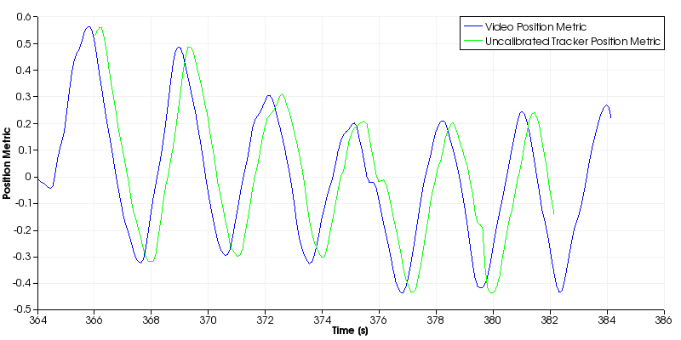
Results
Freehand: Before alignment

Slide 81
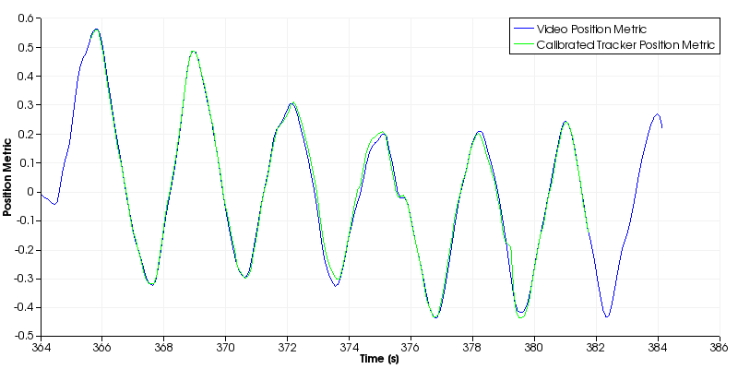
Results
Freehand: After alignment

Slide 82
Results
Baseline study results for collections on two different days
Day one (mean=0.4091s, std=0.0066s)
Day two (mean=0.3920s, std=0.0040s)
Tracker Offset (sec)
Trial Number

Slide 83

Results
Demo

Slide 84
Conclusions and Future Work
Developed a temporal calibration scheme based on the work of Treece et al.
Continuing to test under a range of different imaging parameters
Extending methodology to rotational motion (e.g. for endo-rectal probe)
All source code is freely available in the Public software Library for Ultrasound imaging research (PLUS)

Slide 85
Acknowledgments
Thanks to:
Tamas Ungi: Data collection
Csaba Pinter: Integration into PLUS GUI

Slide 86

Thank You!
Notes:
http://richardwiseman.wordpress.com/2009/05/21/its-the-friday-puzzle-9/

